Slide 1
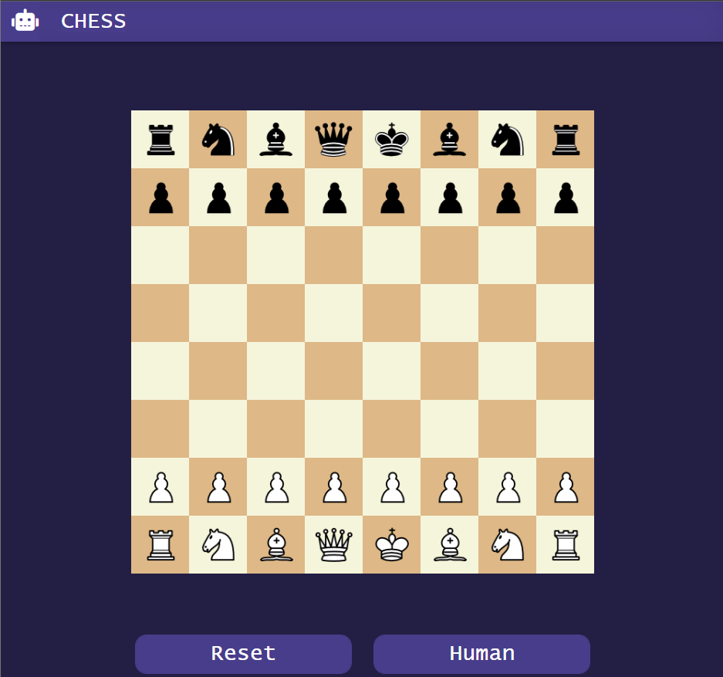
Chess Senior Project
Matt Caraher

Slide 2
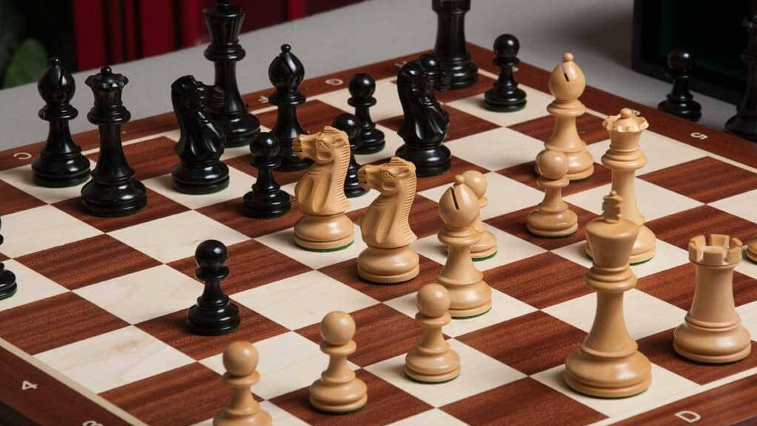
Why I chose Chess

Slide 3



Technology Used
HTML
CSS
JavaScript

Slide 4
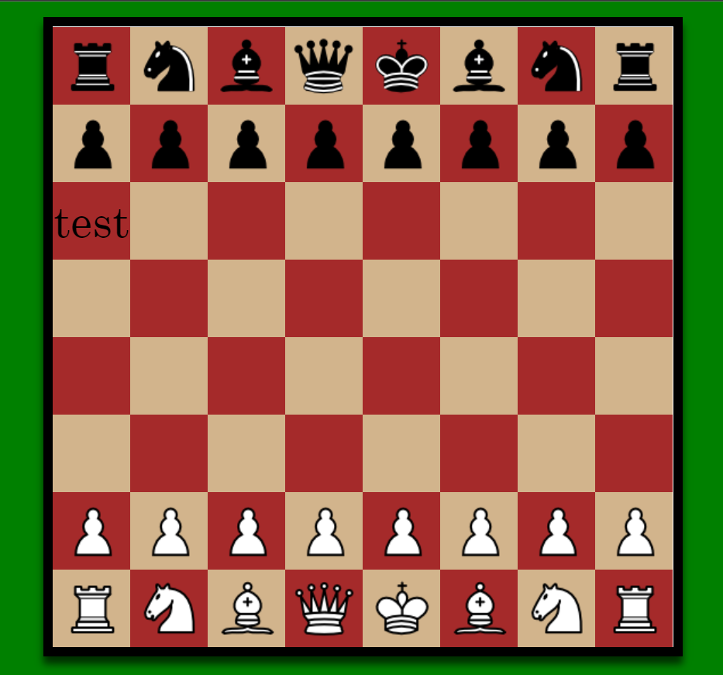
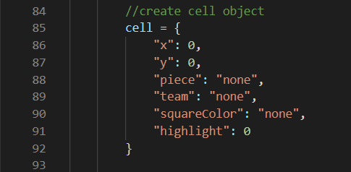
Board made in Canvas
Made with Canvas
64-length (8x8) array of cells

Slide 5
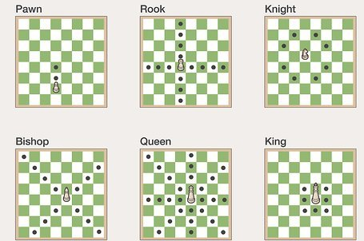
Basic Chess Rules

Slide 6

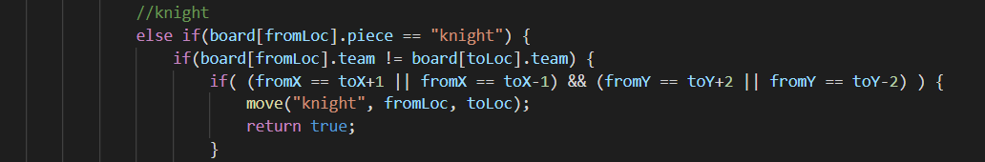
Game logic

Slide 7
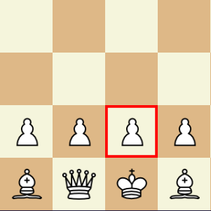
Clicking and highlighting
Canvas checks for what part of the board was clicked
getClick() function checks which cell the click was in
If it was the first click, it highlights
If a piece is highlighted and the second click is a valid move, it moves

Slide 8
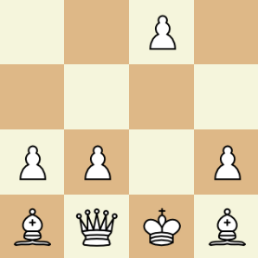

Moving the pieces

Slide 9
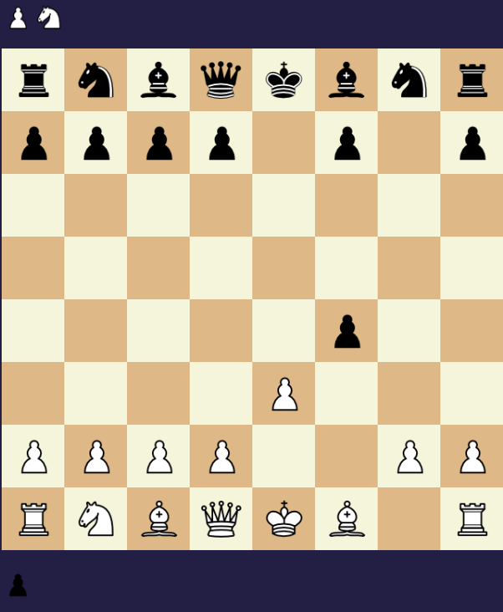
Captured Pieces

Slide 10
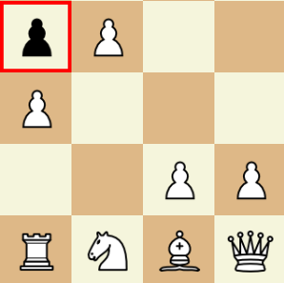
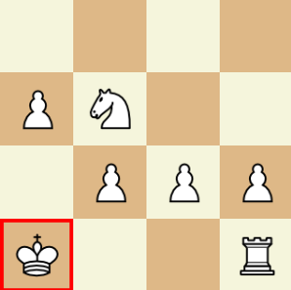
Special Rules
Castling
En Passant

Slide 11
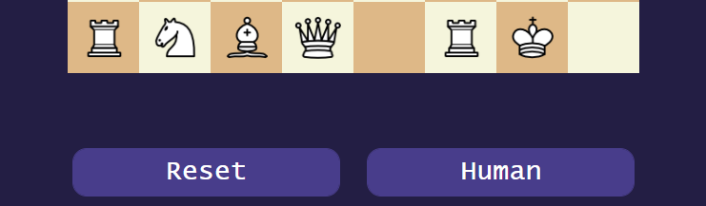
Buttons and sounds

Slide 12

AI Bot

Slide 13
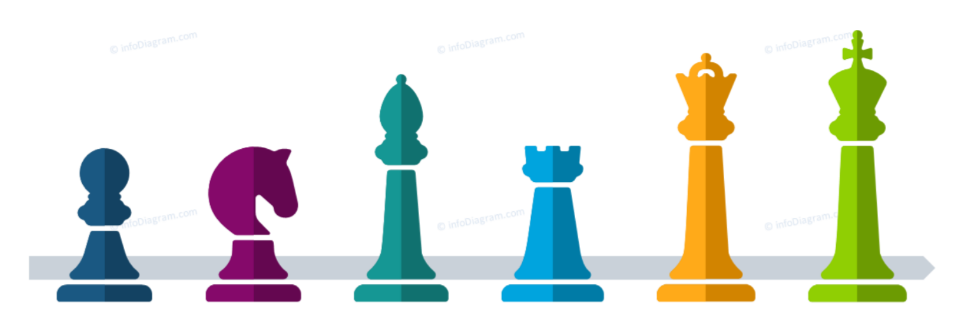
Piece Weights
1
3
3
9
∞
3
5

Slide 14
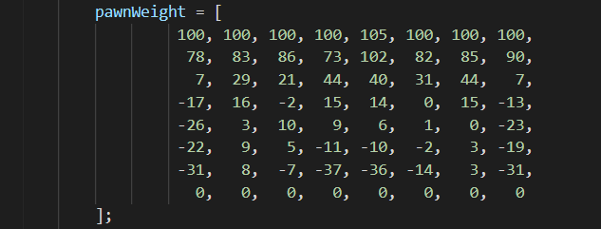
Creating all possible moves
evaluateBoard() gives a heuristic for a given board
The bot checks all possible moves (from one square to another) checking a total of 4096 possibilities

Slide 15
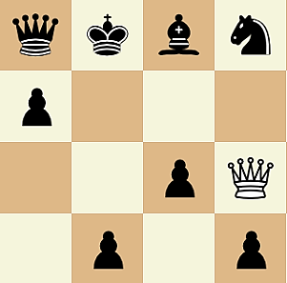
Choosing the best Move
Playing as black, the bot’s objective is to minimize the heuristic. White aims to maximize it.
At the end of each potential move evaluation, the bot checks if that move is less than the current minimum.
After all possibilities are checked, the bot is left with the move that is closest to -∞

Slide 16
What I did not finish
Add more depth to the AI
Add some difficulty settings to the bot
More customization for the board and colors
What I Learned
Writing functions out and planning ahead

